Slide 1
Luca Porcu & Chandra Chilamakuri (Bioinformatics core)
21st February 2025
Linear regression models
Fixed-effects models

Slide 2
Process flow
Stage 1
Stage 2
Stage 3
Stage 4
Effects and regression models
Analysis of variance (ANOVA)
Simple regression model
Multivariable regression model

Slide 3
Simple regression model
Definition and classification
11.00 - 11.20 am
Quantitative predictor

Slide 4
Simple regression model
4
1. The unit k (e.g. mouse), k = 1,…,n
Equation of the statistical model:
y_{k} = 𝛃₀ + 𝛃₁ x_{k} + ε_{k}
2. 𝛃₀ : intercept of the model; 𝛃₁: slope of the model (i.e. effect of predictor X)
3. ε_{k}: the random part of the model (i.e. error term of the model). It is a blanket characterization of the uniqueness of the k_{th} unit
n =100
Systematic component
+/- 1.96 ⋅ SD
Assumptions of simple regression models are the following:
The true relationship between 𝛍_{Y} and the quantitative predictor X is linear
ε_{k} is assumed to be independent of one another and normally distributed with mean = 0 and common standard deviation = σ

Slide 5
Estimation of parameters 𝛃₀, 𝛃₁ and 𝛔
5
> library(GLMsData) # Load the GLMsData package
> data(lungcap) # Make the dataset lungcup available
> head(lungcap) # Show the first observations
> dSet = subset(lungcap, Smoke==1) # Select smokers
> plot(dSet$Ht, dSet$FEV, xlab = "Height in inches", ylab = "FEV") # Scatter plot
A simple regression model is reasonable

Slide 6
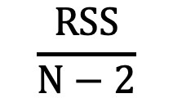
Estimation of parameters 𝛃₀, 𝛃₁ and 𝛔
6
> beta1a = 0.35; beta1b = 0.25; beta1c = 0.15; # Plausible slopes
> beta0a = -20.1; beta0b = -13.5; beta0c = -6.9; # Plausible intercepts (x=66; 𝛍_{Y} ≃ 3.0)
> RSSi = sum((dSet$FEV - (beta0i + beta1i * dSet$Ht))^2) # i = a, b, c
> print(c(RSSa, RSSb, RSSc) # Show residual sum-of-squares (RSS)
Output
[1] 47.55759 29.36609 24.22459
a
b
c
𝛃₀ and 𝛃₁ estimators are those values that minimize RSS
$$\frac{RSS}{N−2}$$
𝛔² estimator is given by

Slide 7
Hypothesis testing and estimation in R
7
> fittedModel = lm(FEV ∼ Ht, data = dSet) # Model fitting
> summary(fittedModel); # Output
Output
Coefficients:
Estimate Std. Error t value Pr(>|t|)
(Intercept) -7.40165 1.41588 -5.228 2.07e-06 ***
Ht 0.16191 0.02144 7.551 2.18e-10 ***
> confint(fittedModel) # 95% confidence intervals of 𝛃₀ and 𝛃₁
Output
2.5 % 97.5 %
(Intercept) -10.2310609 -4.5722344
Ht 0.1190583 0.2047593

Slide 8
Diagnostics: residuals
8
> dSet$resid = resid(fittedModel) # Raw residuals (difference between the observed data of the dependent variable Y and the fitted value)
> plot(dSet$Ht, dSet$resid, xlab = "Height in inches", ylab = "Raw residuals") # Plotting residuals against predictor
> hist(dSet$resid) # Histogram
> qqnorm(dSet$resid); qqline(dSet$resid) # Q-Q plot
> shapiro.test(dSet$resid); # Shapiro-Wilk normality test
Shapiro-Wilk normality test
data: dSet$resid
W = 0.98933, p-value = 0.8509
We can detect heteroscedasticity and asymmetrical distribution of residuals
We can check normality assumption of residuals

Slide 9
Outliers observations
9
> outlier = data.frame("Age"=14, "FEV"=7.000, "Ht"=66.0, "Gender"="M", "Smoke"=1) # Outlier
> dSetOutlier = rbind(dSet,outlier) # Adding the outlier to the data set
> plot(dSetOutlier$Ht, dSetOutlier$FEV, xlab = "Height in inches", ylab = "FEV in liters") # New scatter plot
Outlier
Question: is it an influential observation?
> fittedModel = lm(FEV ∼ Ht, data = dSetOutlier) # Model fitting
> summary(fittedModel); # Output
Output
Coefficients:
Estimate Std. Error t value Pr(>|t|)
(Intercept) (-7.40165) -7.3624 (1.41588) 1.8421 (-5.228) -3.997 (2.07e-06 ***) 0.000169 ***
Ht (0.16191) 0.1622 (0.02144) 0.0279 (7.551) 5.813 (2.18e-10 ***) 2.11e-07 ***

Slide 10
Influential observations
10
> InfObs = data.frame("Age"=14, "FEV"=2.000, "Ht"=40.0, "Gender"="M", "Smoke"=1) # Influential observation
> dSetInfObs = rbind(dSet,InfObs) # Adding the influential observation to the data set
> plot(dSetInfObs$Ht, dSetInfObs$FEV, xlab = "Height in inches", ylab = "FEV in liters") # New scatter plot
Outlier and far away x-value observation
Question: is it an influential observation?
> fittedModel = lm(FEV ∼ Ht, data = dSetInfObs) # Model fitting
> summary(fittedModel); # Output
Output
Coefficients:
Estimate Std. Error t value Pr(>|t|)
(Intercept) (-7.40165) -3.63162 (1.41588) 1.08780 (-5.228) -3.339 (2.07e-06 ***) 0.00141 ***
Ht (0.16191) 0.10508 (0.02144) 0.01655 (7.551) 6.348 (2.18e-10 ***) 2.55e-08 ***

Slide 11
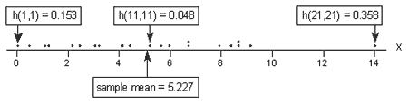
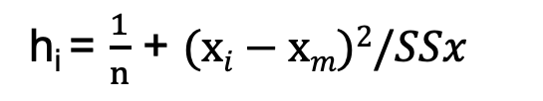
Observations with high leverage
11
An observation is considered to have high leverage if it has a value (or values) for the predictor variables that are much more extreme compared to the rest of the observations in the dataset.
h_{i} = $\frac{1}{n}$ + $(xi−xm)2/SSx$
> hats = hatvalues(modelFitted) # Computing leverage of each observation
h_{i} | leverage of observation i
x_{i} | predictor value of observation i
x_{m} | sample mean of the predictor
SS_{x} | sum of the squared difference between the predictor value of observation i and the sample mean of the predictor
n | number of observation
Large values of h_{i} (perhaps two or three times the mean value of the h_{i}) identify observations with unusual values of the predictor

Slide 12
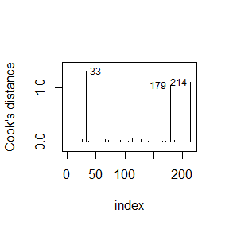
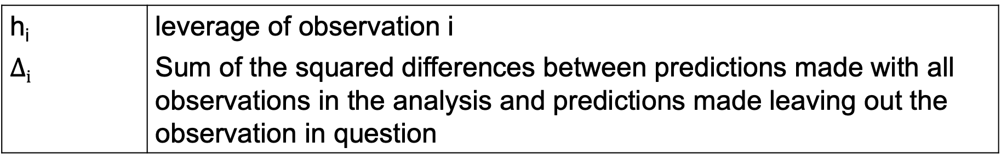
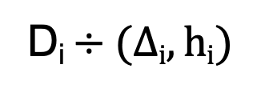
Influential observations
12
Influential observations are outliers with high leverage.
A popular measure of influence for observation i is Cook’s distance:
D_{i} $÷(∆i,hi)$
> cookDistance = cook.distance(modelFitted)
# Computing Cook’s distance of each observation
h_{i} | leverage of observation i
$$∆i$$ | Sum of the squared differences between predictions made with all observations in the analysis and predictions made leaving out the observation in question
A rule of thumb is that observations with D > 1 may be flagged as potentially influential.
> cook_plot(modelFitted, id_n = 3)
# Computing Cook’s distance of each observation

Slide 13
Source of problems and possible solutions
13
Solution | Linearity | Normality | Unequal variance | Outliers | Influential observations
Weighting |  |  | ✓ | ✓ | ✓
Introducing other predictors (multivariable model) | ✓ | ✓ | ✓ | ✓ | ✓
Data transformation | ✓ | ✓ | ✓ | ✓ | ✓
Different random component (e.g. gamma, beta, Poisson) and g(𝝁) |  | ✓ | ✓ | ✓ | ✓

Slide 14
Introducing other predictors
14
Equation of a plausible statistical model:
y_{k} = 𝛃₀ + 𝛃₁ x_{k} + 𝛃₂ x_{k}² + ε_{k}

Slide 15


Data transformation
15
> plot(lungcap$Ht, lungcap$FEV, xlab = "Height in inches", ylab = "FEV") # Scatter plot
> lungcap$logFEV = log(lungcap$FEV) # log transformation of the response variable
> plot(dSet$Ht, dSet$logFEV, xlab = "Height in inches", ylab = "FEV on log scale") # Scatter plot
Response on natural scale
Response on log_{e} scale

Slide 16
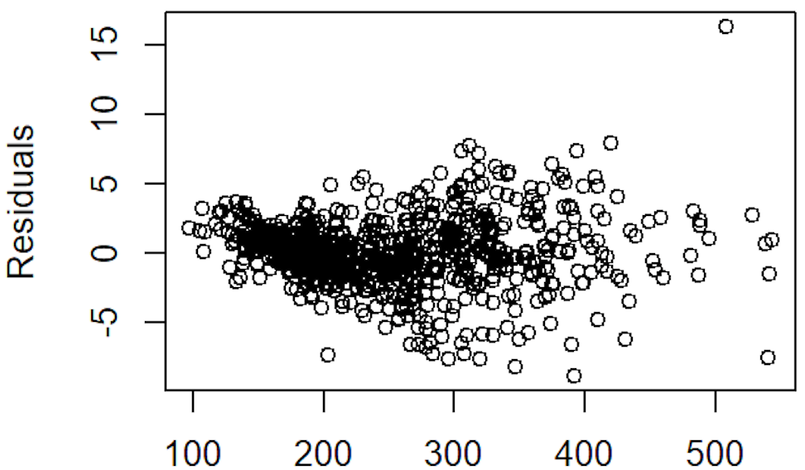
Weighted least square
16
> library(nlme) # Load the nlme package
> fittedModel = gls(Response ∼ Predictor, weight = varPower( ∼ Predictor) , data = dSet)
# Modeling variance as function of the predictor
> summary(fittedModel) # Output

Slide 17
Different random component and g(𝝁)
17
> library(GLMsData) # Load the GLMsData package
> data(nminer) # Make the dataset nminer available
> plot(jitter(Minerab) ~ Eucs, data=nminer, las=1, ylim=c(0, 20), xlab="Number of eucalypts per 2 ha", ylab="Number of noisy miners" ) # The number of noisy miners plotted against the number of eucalypt trees
Y = Poisson(𝝁) | Random component
log (𝝁) = 𝛃₀ + 𝛃₁ x | Systematic component

Slide 18
Hands on
https://bioinformatics-core-shared-training.github.io/ Fixed-and-Mixed-effects-models/

